Slide 1

Flow charts AND pseudocode
2. Computational Thinking

Slide 2
Flow chart
A graphical representation of an algorithm

Slide 3
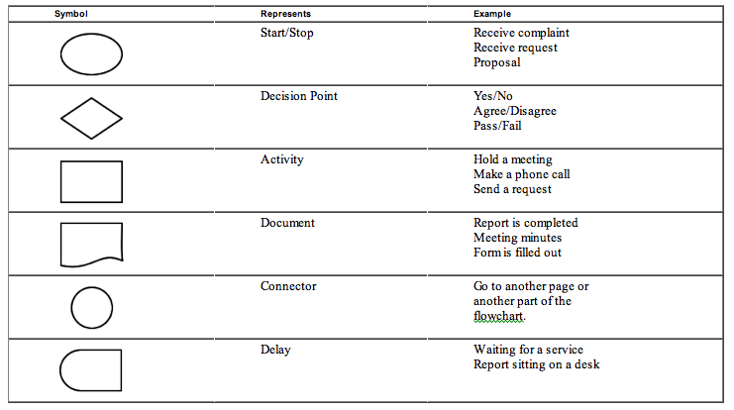

Slide 4
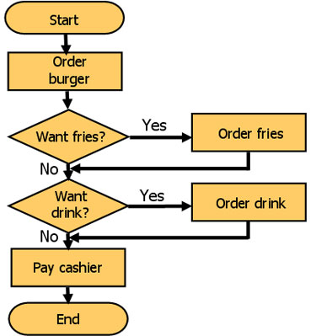

Slide 5
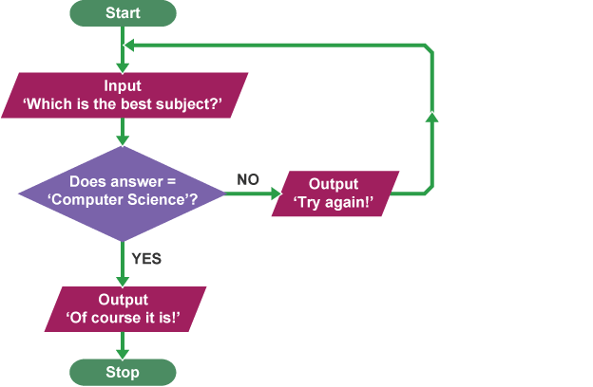

Slide 6
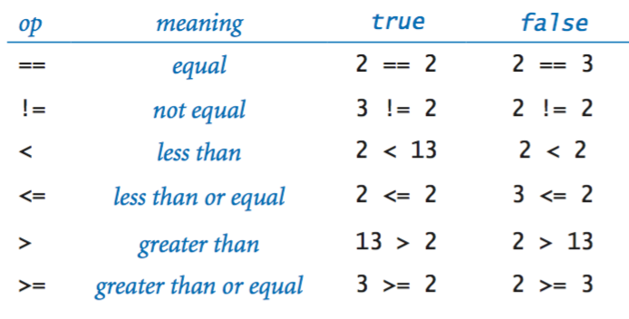

Slide 8
CHALLENGE
Display all numbers from 50 to 0 on decreasing order.

Slide 9
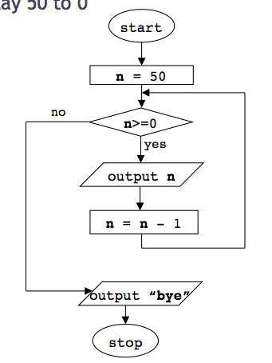

Slide 10


Slide 11
Activity
More flow charts!

Slide 12
Data types
What and how can be used

Slide 13
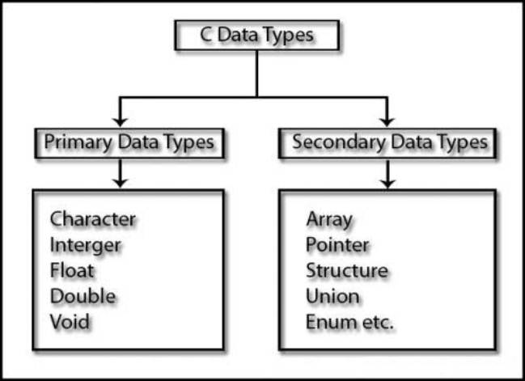
Primitives in C

Slide 14
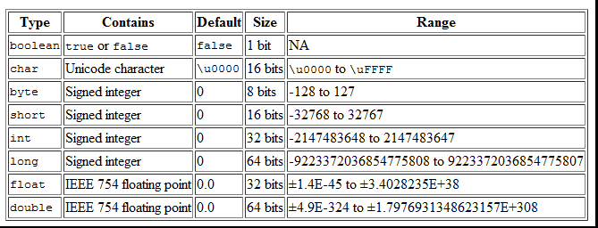
Primitives in Java

Slide 15
Basic Data Types
Integer
Double / Float (decimals)
Char
String (combination of chars)
Boolean
Others:
Array
Hash Table
Etc.

Slide 16
Thanks.
@edolopez - edolopez@hackerschool.mx

